Slide 1






PYTHON BEGINNER COURSE
2024
2024
PYTHON
BEGINNER COURSE
Lesson 4
SHALEV LAU
/in/shalevl
/mushroomhater07
Notes:
f

Slide 2
Week 3: List and

Slide 3
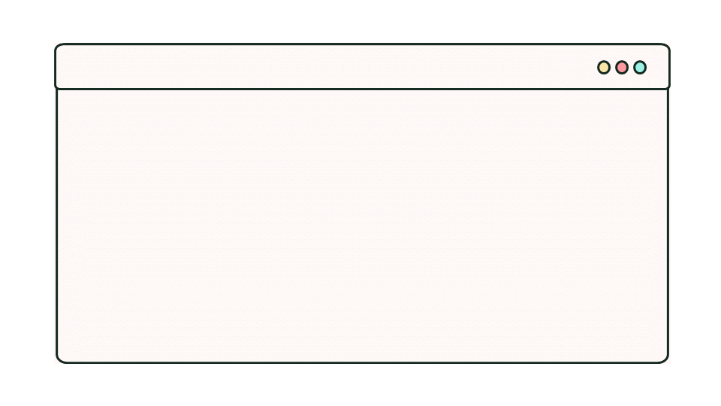
Recap exercise
Program (completed in For-loop exercises):
Ask the user to enter 10 numbers. At the end, tell them the mean average, maximum and minimum of the values entered.
Solution:
Use 10 different variables to store each number.
answer0 = int(input("enter 1st number"))
answer1 = int(input("enter 2nd number"))
answer2 = int(input("enter 3th number"))
answer3 = int(input("enter 4th number"))
answer4 = int(input("enter 5th number"))
answer5 = int(input("enter 6th number"))
answer6 = int(input("enter 7th number"))
answer7 = int(input("enter 8th number"))
answer8 = int(input("enter 9th number"))
answer9 = int(input("enter 10th number"))
“Code Efficiency”

Slide 4
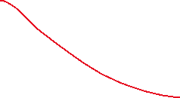
Recap exercise
Program (completed in For-loop exercises):
Ask the user to enter 10 numbers. At the end, tell them the mean average, maximum and minimum of the values entered.
Solution:
Use 10 different variables to store each number.
answer0
answer1
answer2
answer3
answer4
answer5
answer6
answer7
answer8
answer9
0
1
2
answer =
3
4
5
6
7
8
9

Slide 5
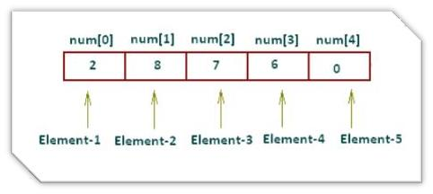
List
Each element in the list shares the same name but a different index
index is a number which indicates the position of the element in the array.
In Python, the first element of a list start from 0

Slide 6
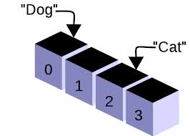
List
We create a list by placing elements inside square brackets [], separated by commas.
Python list allow you to create a list with mixed DataType
myList = ["car", "bus", "train"]
mixed_types = [ ["Elton", 90], 95, "John", False ]
List
string
Boolean
(True or False)
Integer
(number)

Slide 7
List operation 1
myList = ["car", "taxi", "train"]
myList = ["car", "bus", "train"]
Access item in list:
List[index]
List[start:end]
Change item in list:
List[index] = value
Get Length
len(List)
myList[1]
# bus
myList[1:]
# ["bus", "train"]
myList[:2]
# ["car", "bus"]
myList[1] = "taxi"
len(myList)
# 3

Slide 8
List operation
myList = ["train", "taxi", "car"]
myList = ["car", "taxi", "train"]
myList = ["train", "taxi", "car","rocket"]
myList = ["train", "car", "rocket"]
myList = ["train", "taxi", "car","rocket",1,2]
myList.reverse()
myList.append("rocket")
myList.remove("taxi")
":".join(myList)
reverse
append
remove
seperator.join
List1 + List2 =
If “Ben” not in names
# train:taxi:car:rocket
myList = myList + [1, 2]
if "rocket" not in myList:
print("impossible")
else:
print("possible")

Slide 9
List operation
myList.reverse()
print(myList)
print(myList.reverse())
# None
# ["train", "taxi", "car", "rocket"]

Slide 10
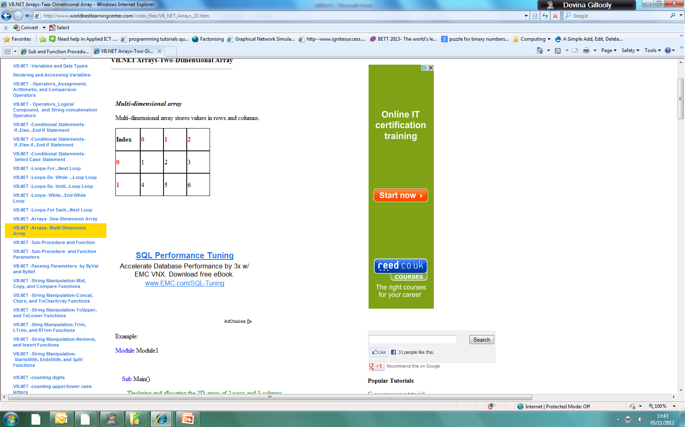
Multi-dimensional list
stores values in rows and columns
Can be store with nested list
students_grades = [ ["Elton", 90], ["Bernie", 95], ["John", 40] ]
Elton | 90
Bernie | 95
John | 40

Slide 11
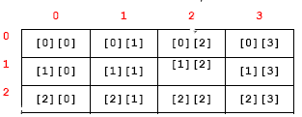
Nested Loop
A nested loop refers to a loop statement inside another loop statement
Useful scenario:
2D coordinate (x, y)
for i in range(4):
for j in range(3):
print(i, j)

Slide 12
Tuple
Tuple - ordered, allowing duplicates, unchangeable.
Mixed DataType in tuple
Access item:
Get the sum:
Get the length:
Get the maximum:
numbers = (1, 2, -5)
names = ("Elton", "Bernie", "John")
names[1]
sum(numbers)
len(names)
max(numbers)

Slide 13
For loop in list (detailed
lists = ['apple', 'orange', 'banana’]
# printing the tuples in object directly
for i in enumerate(lists):
print (i)
# i = counter, item = Actual Value
for i, item in enumerate(lists):
print (i)
print (item)
# changing starting index to 100
for i, item in enumerate(lists, 100):
print (i)
print (item)
# (0, "apple")
# (1, "orange")
# (2, "banana")
# 0
# apple
# 1
# orange
# 2
# banana
# 100
# apple
# 101
# orange
# 102
# banana

Slide 14
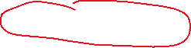
Set
Set - unordered, do not allow duplicates, changeable
Use {} to create a set
Mixed DataType:
Empty Set:
Add item to set:
names = {"Ben", "Alan", "Johnny"}
detail = {21, True, ‘UK’, 21}
detail = {21, True, ‘UK’}
empty = {}
names.add("Jack")
{"Ben", "Alan", "Johnny“, "Jack"}

Slide 15
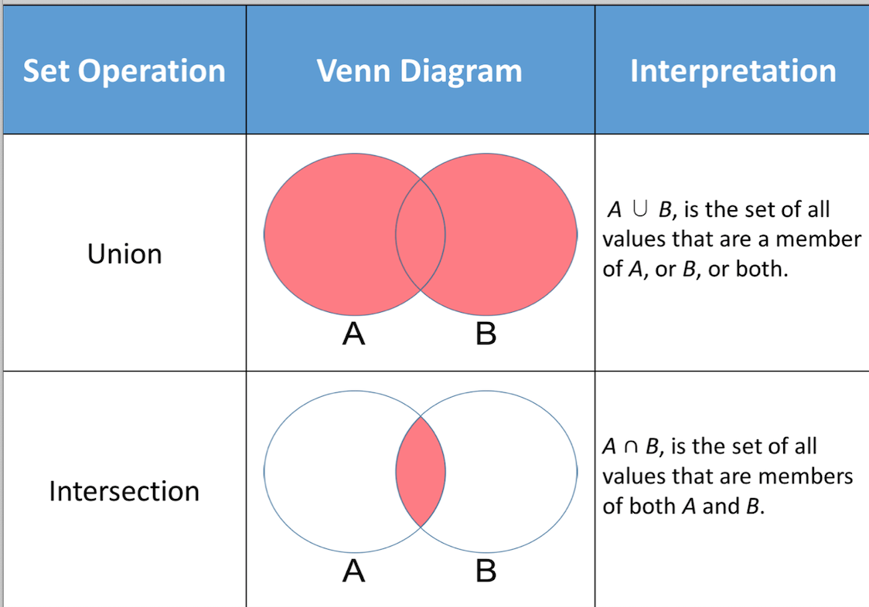
Set

Slide 16
Sets
names1 = {"Ben", "Alan", "Johnny"}
names2 = {"Elton", "Bernie", "John"}
names3 = {"Oscar", "Amy", "John"}
Ben
Elton
Oscar
Alan
Bernie
Amy
Johnny
John
John
names1
names2
names3

Slide 17
names1 = {"Ben", "Alan", "Johnny"}
names2 = {"Elton", "Bernie", "John"}
names1.union(names2)
Union
Ben
Elton
Alan
Bernie
Johnny
John
names1
names2

Slide 18


names2 = {"Elton", "Bernie", "John"}
names3 = {"Oscar", "Amy", "John"}
names3.union(names2)
Union
Elton
Oscar
Bernie
Amy
John
John
names3
names2

Slide 19
names2 = {"Elton", "Bernie", "John"}
names3 = {"Oscar", "Amy", "John"}
names3.union(names2)
Union
Elton
Oscar
Bernie
Amy
John
names3
names2

Slide 20
Set

Slide 21


names2 = {"Elton", "Bernie", "John"}
names3 = {"Oscar", "Amy", "John"}
names3.intersection(names2)
Intersect
Elton
Oscar
Bernie
Amy
John
John
names3
names2

Slide 22
names2 = {"Elton", "Bernie", "John"}
names3 = {"Oscar", "Amy", "John"}
names3.intersection(names2)
Intersect
Elton
Oscar
Bernie
Amy
John
names3
names2

Slide 23
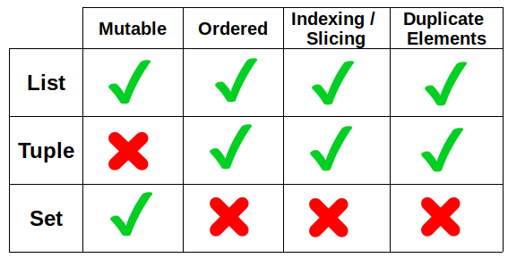
Comparison

Slide 24
Class Exercise
1. Initialise a list of 10 names. Output the array to the screen. Now alter your code to output the list to the screen in reverse order.
2. Write a program to choose 100 random numbers between 1 and 100. Count and display how many numbers are in the range 1-10, 11-20, 21-30 etc.

Slide 25
Challenge Exercise
Declare a list of 7 integers. Initialise each element to 0.
C: Use a loop and random numbers to simulate the rolling of a single die.
B: If a 1 is rolled, increase the value of element 1 in the array by 1, if a 2 is rolled, increase the value of element 2 by 1.
A: When all 200 rolls have been simulated, output the tally to the console.

Slide 26
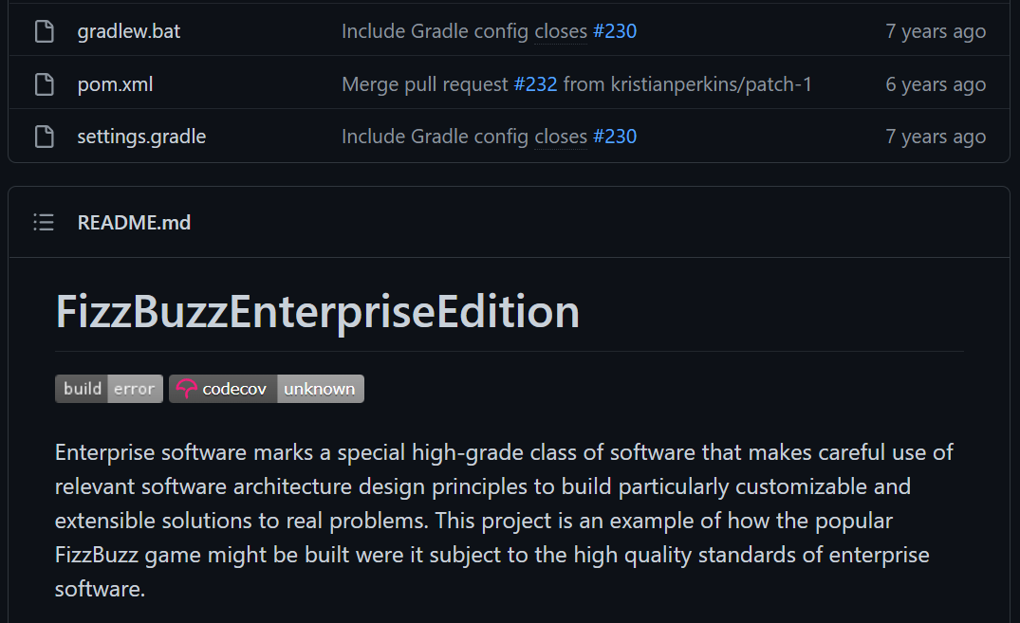
Lecture 2 MINI-Project 2: FIZZBUZZ!
This has become a meme in the software engineering world because it's the simplest question an interviewer can ask you. In fact, someone went to the labour of making it into enterprise ready software for the lols. 😂 CTRL + CLICK on the image to see the repo.
For numbers 1 to 100, for every multiple of 3 print "Fizz" and for multiples of 5, print "Buzz" and for multiples of both 3 and 5, print "FizzBuzz!" otherwise just print the value of num. We've already started the code for you, all you need to do is fill in the control flow logic. Worked solutions will be posted in 5 minutes.
for num in range(1, 101): # We will go over loops next lecture.
# Your code goes here.
# Remember that you need to indent it so it belongs
# to this for loop.

